Slide 1

Critical Design Review (CDR) TerraProbe
A Down2Earth (D2E) Company
3/11/2025

Slide 2





Meet the Team
Awadhoot (Avie) Ghatge
Jacob Mckenrick
Lokesh Sriram
Sankaran Iyer
Christopher Meyers

Slide 3
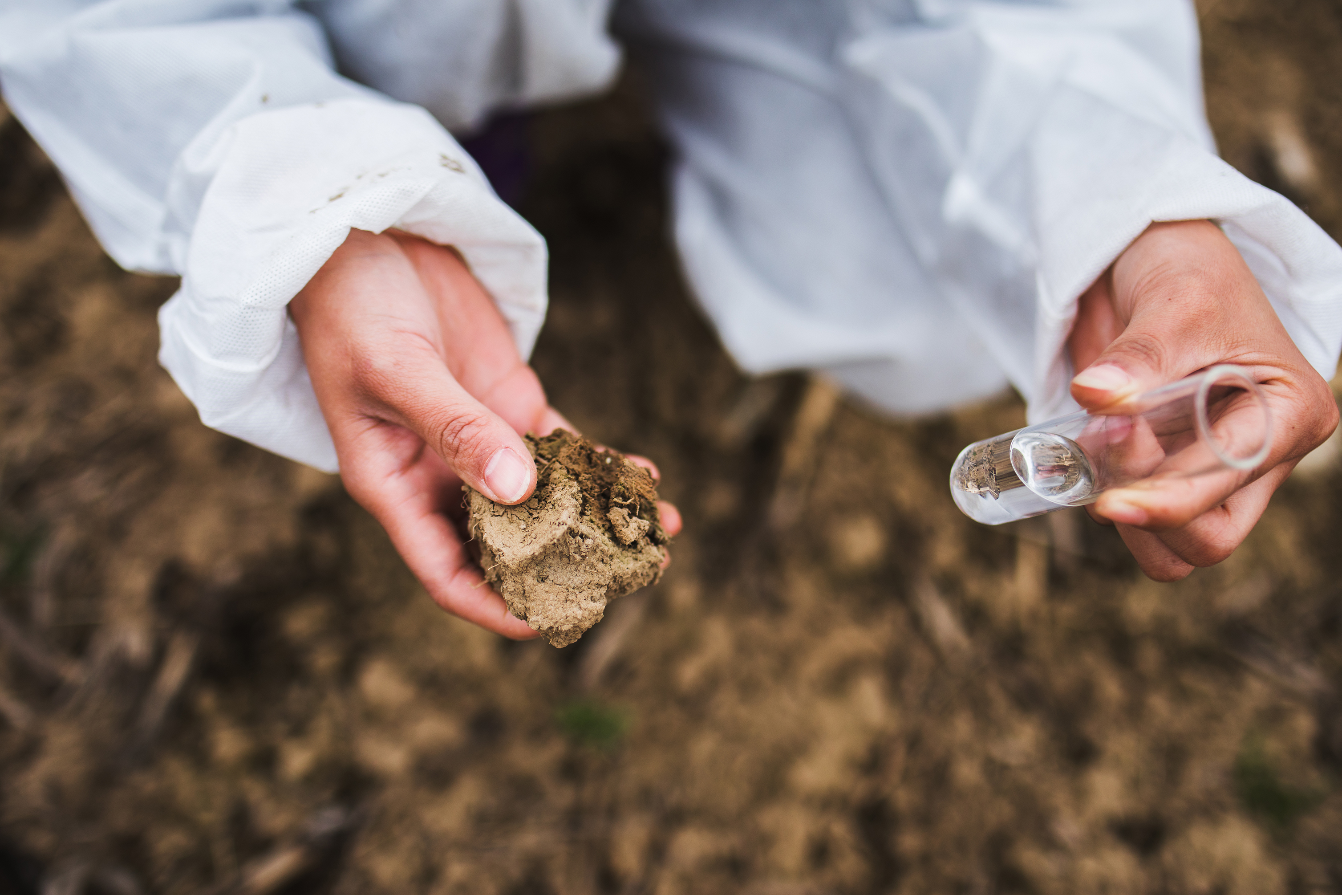
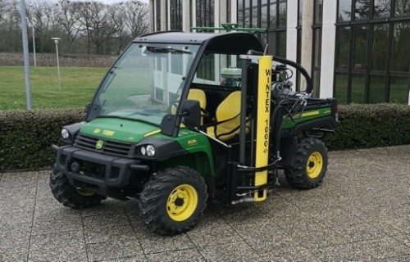
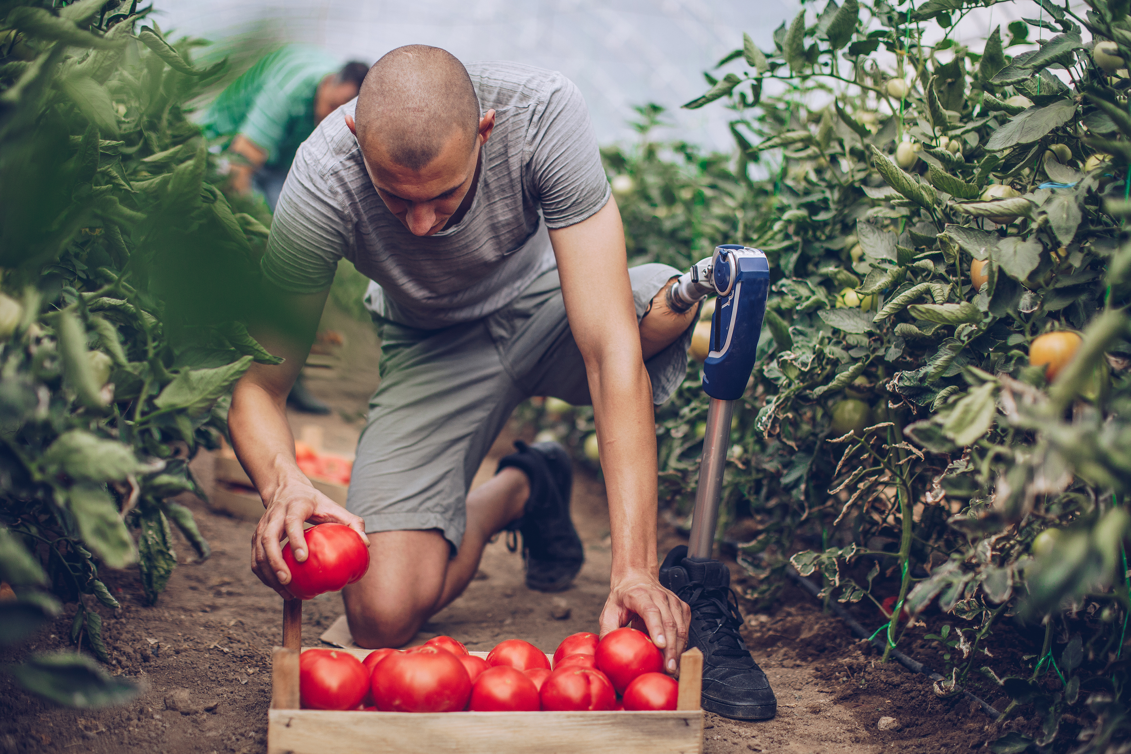
PDR Recap – Problem & Customer Requirements
Soil Testing Challenges: Costly, Slow, and Inaccurate
Soil Testing in Agricultural Industry
Important!
Soil testing process is not optimal
Inaccurate, timely, expensive
Solution & Customer Requirements (Farmers)
Easy to operate
Accuracy in data
Portable
Time Saving
Notes:
Avie – Explain product briefly, encountered by small/medium farms

Slide 4
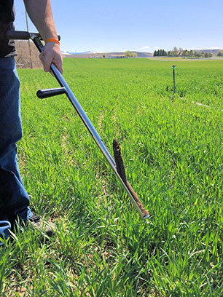

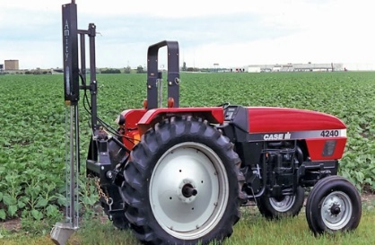
PDR Recap – Competitive Landscape
Current Soil Sampling Solutions are expensive, complex, and outdated
Sampling
Depth
Operation
Type
Real-Time Data
Market Gap for an Intermediate Solution
Portability
Cost
Durability
AMS Soil Probes
Weight: ~1 to 3 lbs Length: ~33 inches | $100-$150 | 24” | Manual | Stainless Steel, requires minimal maintenance | No
Weight: 105 lbs, Requires mount on Vehicle | $8000 | 11.8” | Designed for vehicle sampling, automated sampling | Requires heavy maintenance due to bulky equipment | No
Weight: 210 lbs Requires mount on vehicle | $3000-$6000 | 24 to 48” (Based on model) | Designed for vehicle mounting, automated sampling | Requires standard maintenance | Yes, partners with 3rd party to provide (FARMQA)
Cost: High-end solutions cost $5,000+, while cheaper alternatives lack precision and automation.
Operation: Advanced models require skilled operation, while manual tools are slow and labor-intensive.
Insights: Lab-based testing takes days, preventing real-time decision-making for farmers and researchers.
WintexAgro 1000 Automatic Soil Sampler
Amity Technology Soil Sampler
Notes:
Sankaran
Large market even given a conservative estimate:
Look at current solutions that are capturing the market
Let’s focus on 3 of the most important factors: Portability, Cost, Sampling Depth
AMS is manual and low cost
Wintex Agro and is automated sampling but heavy and very expensive, costing upwards of $8000
AMS Soil Probe is low-end while WintexAgro & Amity are high-end

Slide 5
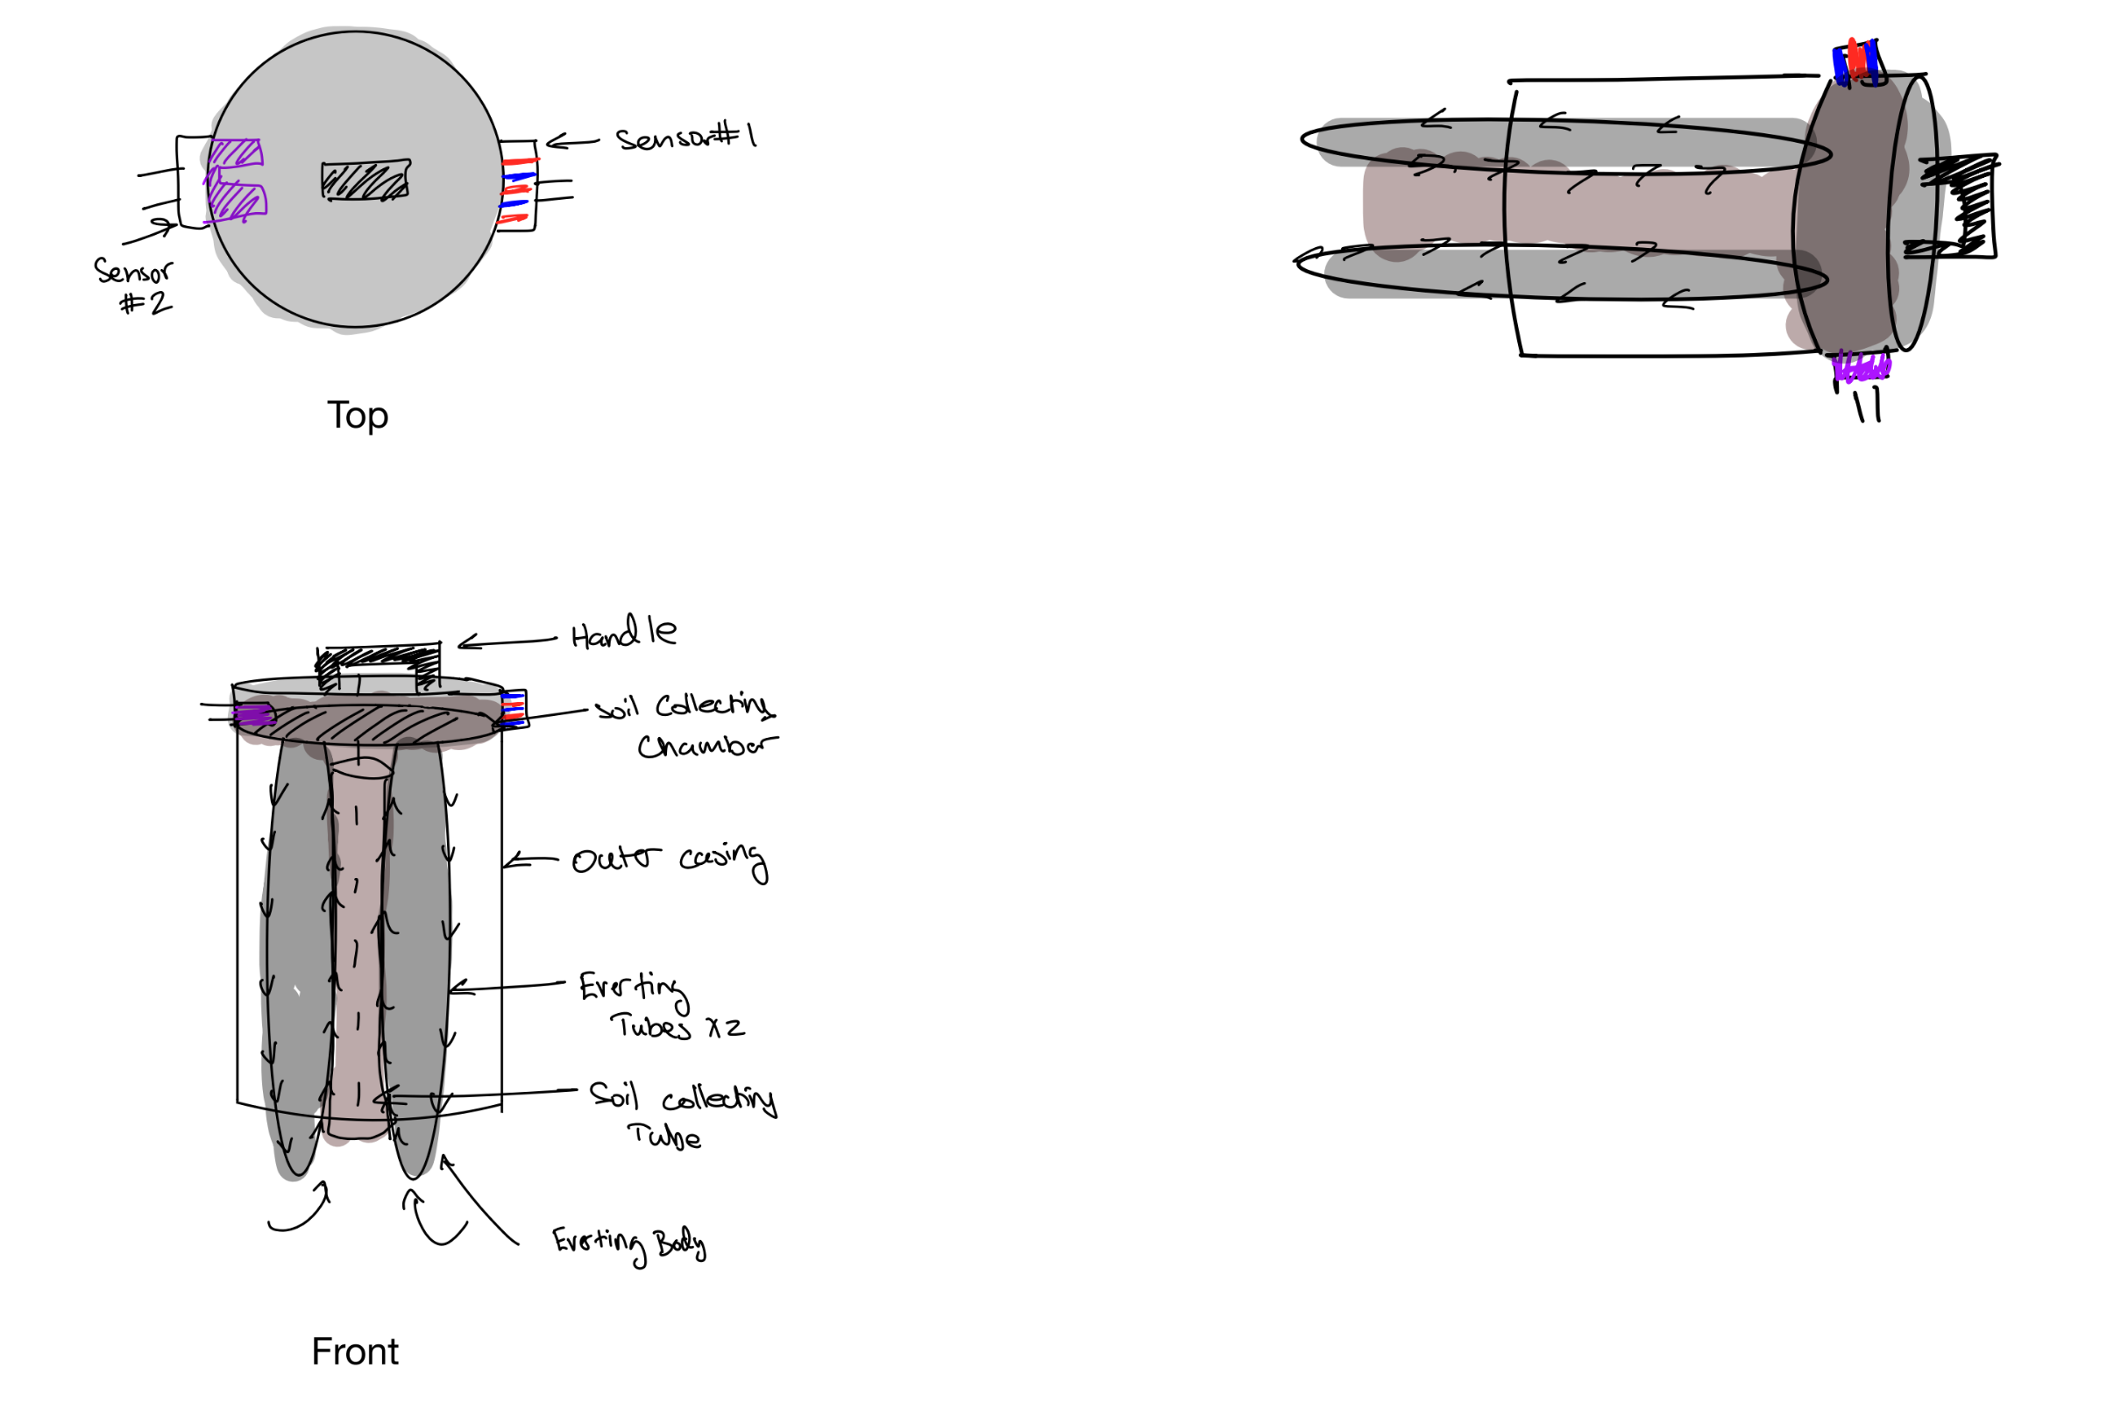
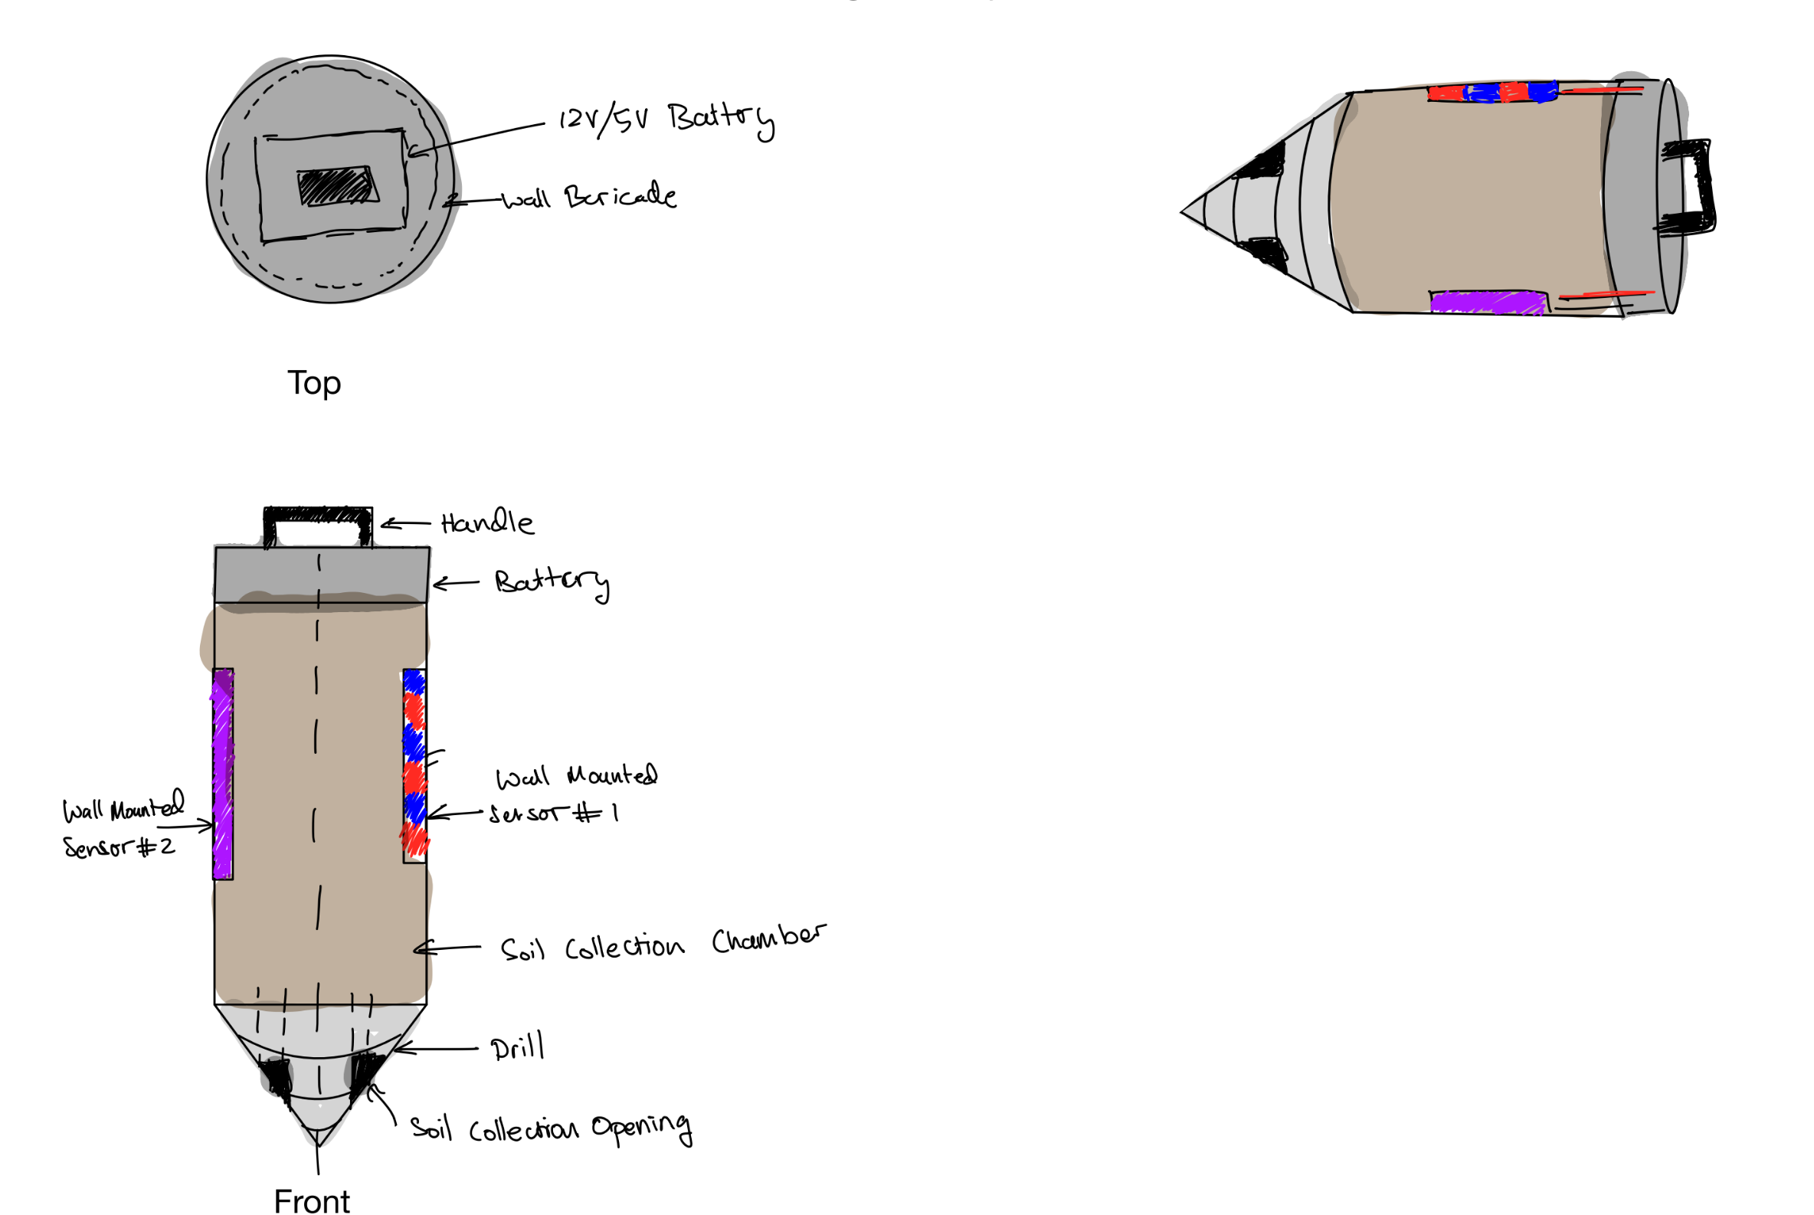
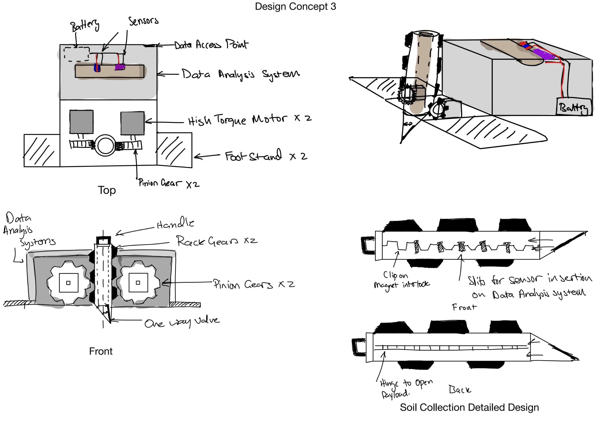
PDR Recap – Design Selection Process
Design process emphasized balancing soil depth profiling/testing, portability, and ease of use
Concept 1
Concept 2
Concept 3 (Selected)
Function:
- Pressurized Gas, everting system
- Can get jammed
Decision Matrix:
- Sampling Accuracy: 5
- Durability: -4
- Precision in depth collection: 5
Total: 36
Function:
- Drill and collect
- High Torque, Can get lodged
Decision Matrix:
- Sampling Accuracy: -5
- Durability: 0
- Precision in depth collection: 5
Total: 23
Function:
- Pushes in ground, collects sample
- Separate Data Acquistion system
Decision Matrix:
- Sampling Accuracy: 10
- Durability: 4
- Precision in depth collection: 10
Total: 52
Notes:
Avie – met soil scientist to discuss requirements such as burrowing depth, not mixing soil, providing enough force and safety. These 3 designs were built based on that in mind… what made the most diff: three chosen were the ones that made the most difference

Slide 6
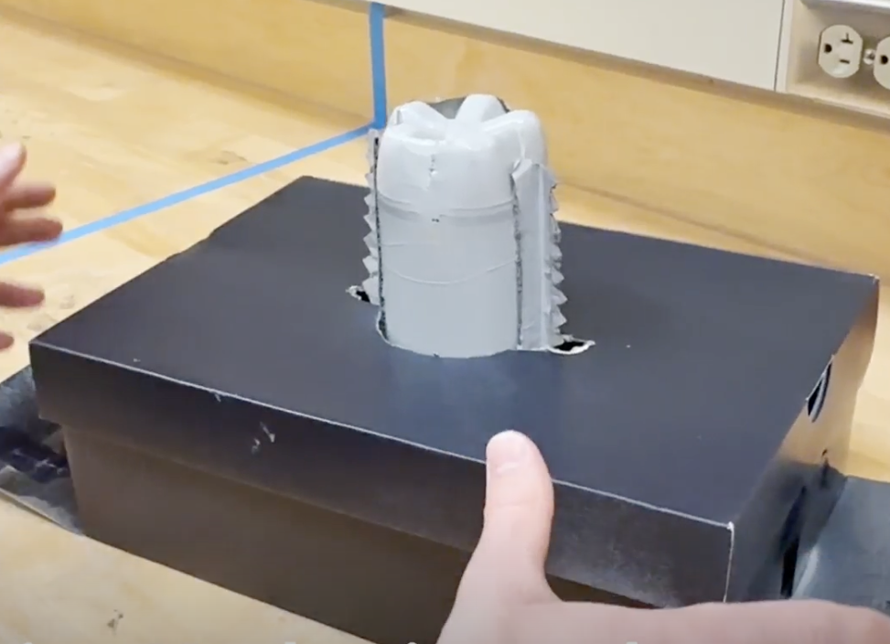
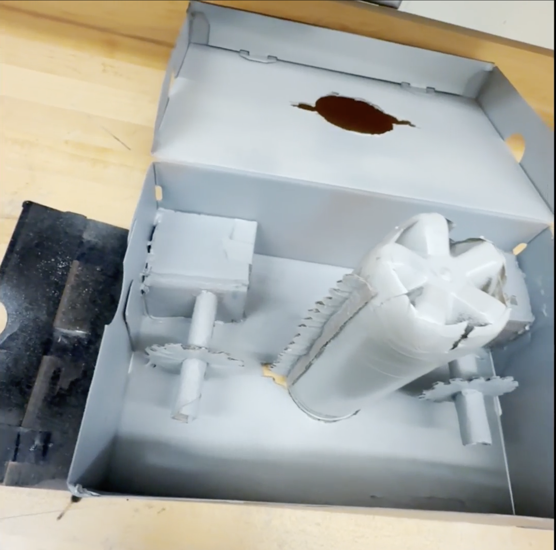
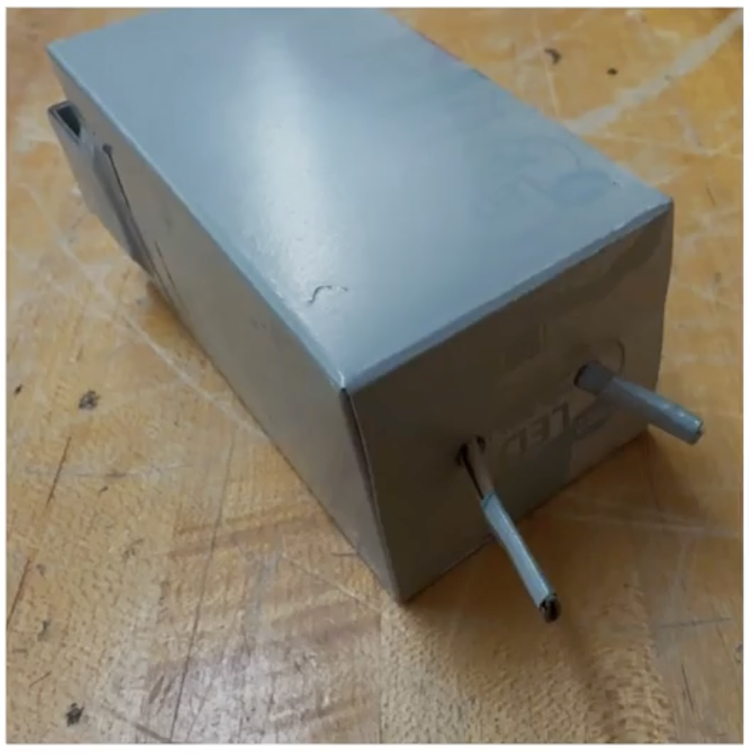
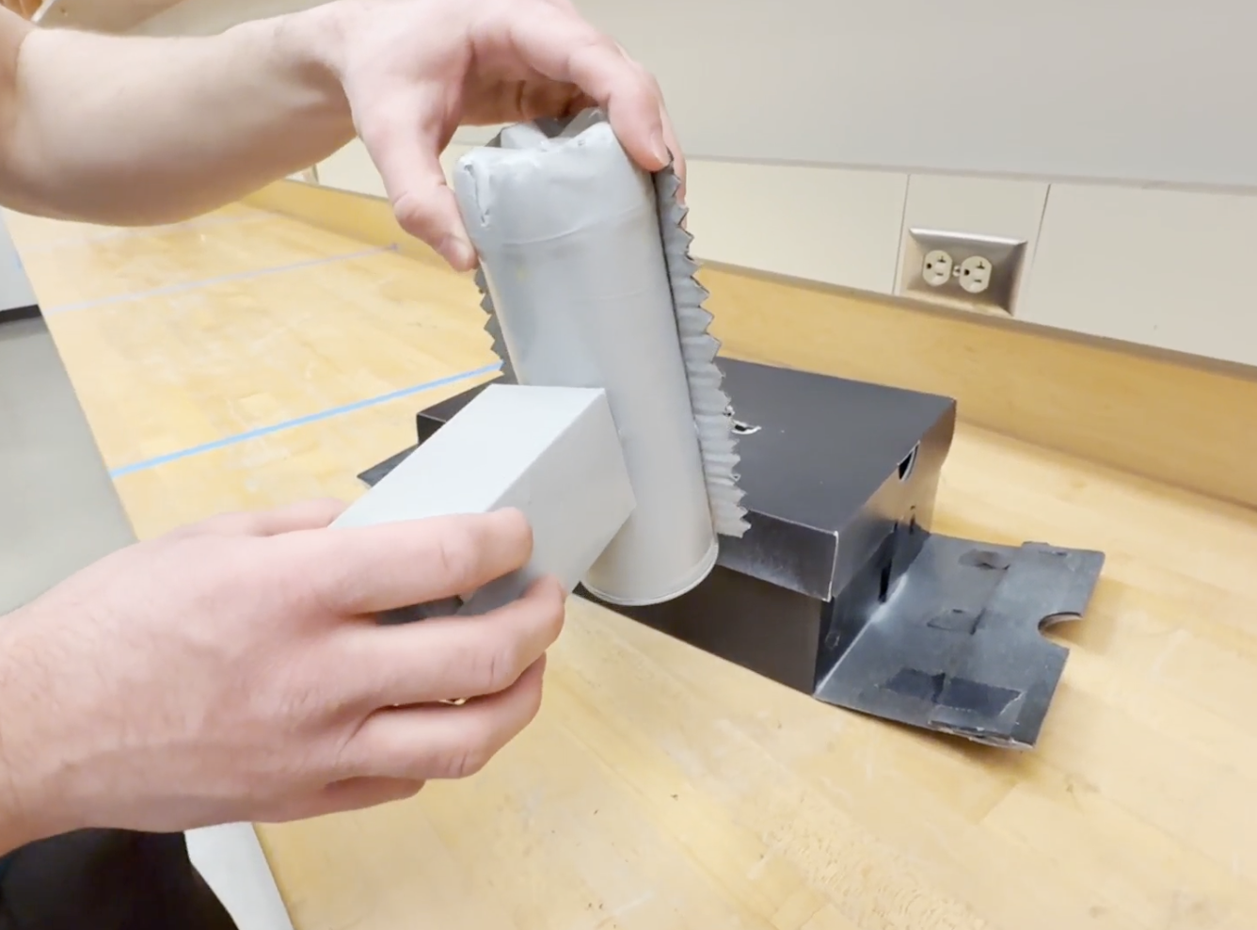

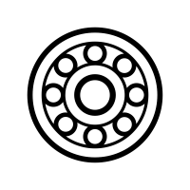

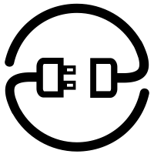
PDR Recap – Prototype & Learnings
Focused target customers and made appropriate mechanical and software changes
TerraProbe Assembly
Motor-Shaft-Gear System
Soil Testing Probe
Testing & Slits Design
Key Learnings
Converted Foot
Pedals into Dual
Purpose Handle
Added Bearings for
Increased Safety
Determined Spacing
& Wire Management
for Electronics
Increased Slit Height
& Width for Sensor Accommodation
Notes:
Jacob

Slide 7



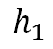
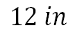
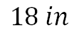
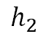
Major Changes Since PDR
Focused target customers and made appropriate mechanical and software changes
Streamlined Target Market
Mechanical Changes
Software Changes
Primary Focus
Payload cross-section:
Removed Temperature Sensor
Changed from ESP 32 to Arduino UNO
Wireless Dashboard to see live sensor results and preliminary analysis
Payload Height :
Agricultural
Secondary Focus
$$h_{2}$$
$$h_{1}$$
$$18 in$$
$$12 in$$
Research
Construction
Notes:
Loki bhai

Slide 8
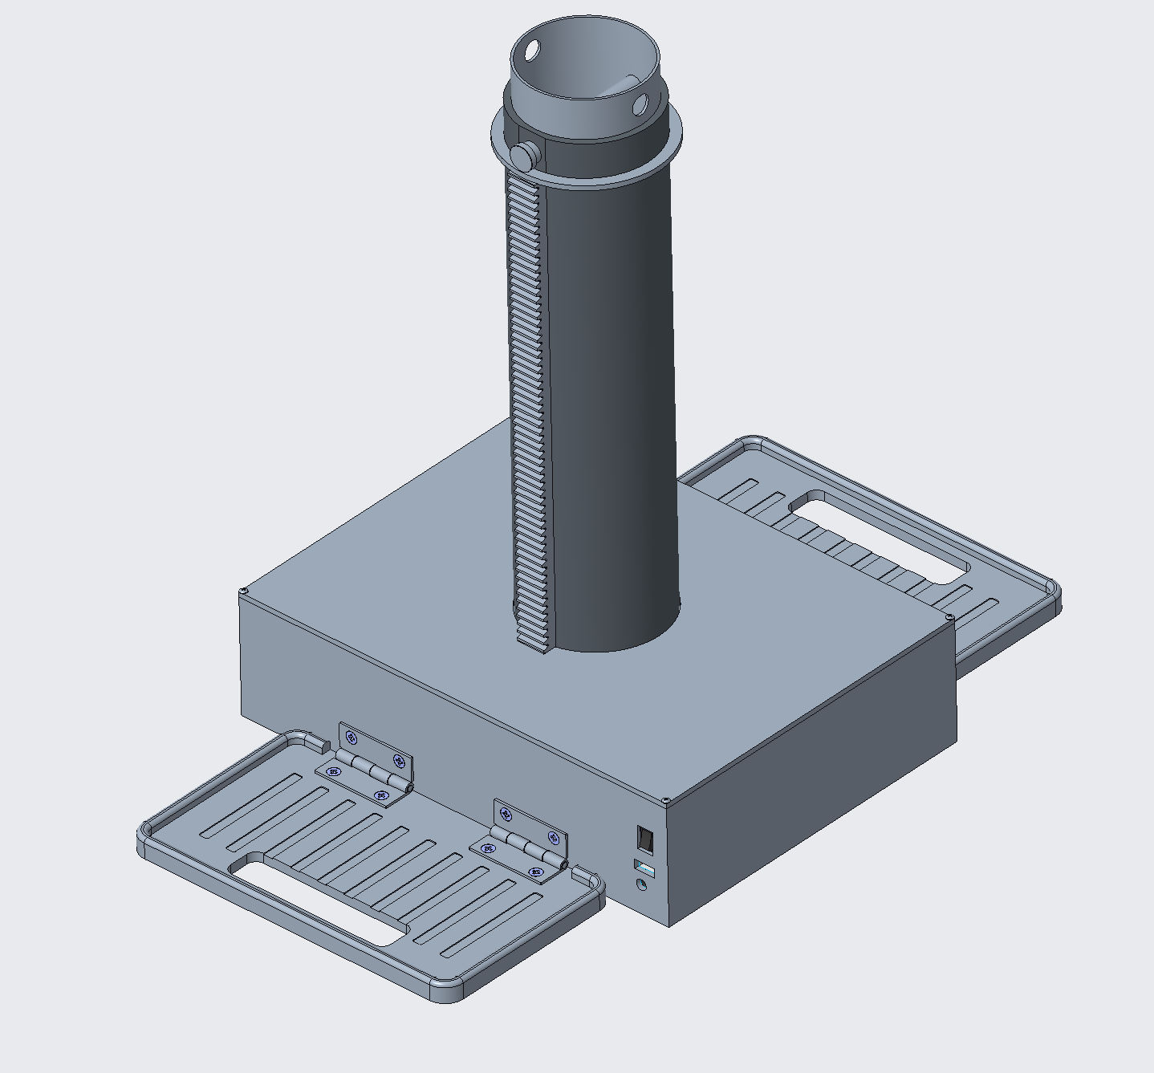
Key Product Features & Functions
TerraProbe presents a compact, affordable, user-friendly product, with real-time data insights.
Customer Design Features:
Compact Design: 10” x 12” x 17”, 35 lbs. for easy portability
Motor-Controlled System: Rack and pinion mechanism drives payload into soil
User-Friendly Features: Foldable foot pedals for added force, removable top lid for maintenance
Integrated Testing Probe: Measures moisture, NPK levels for real-time data analysis
Modular Inner Payload: Replaceable soil collection chamber
Mechanical Design Features:
Rack and pinion: Drives payload and outer shell into the ground
Foldable foot pedals: Allow users to apply downward force for improved penetration.
Removable top lid: Provides easy access for maintenance and cleaning.
Limit switch mechanism: Prevents over-extension of the outer shell during operation.
Notes:
Chris

Slide 9
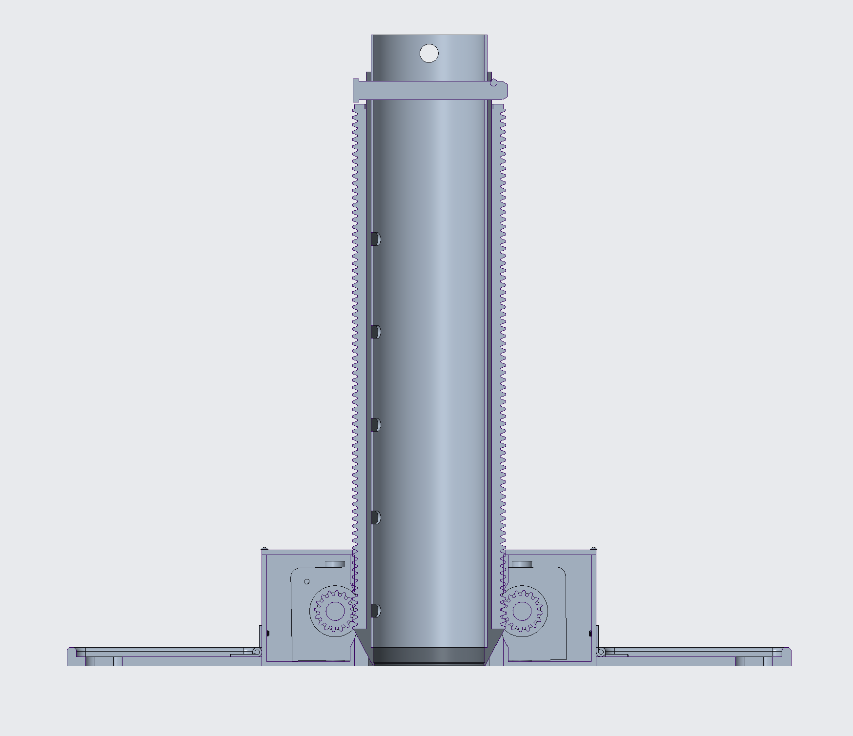
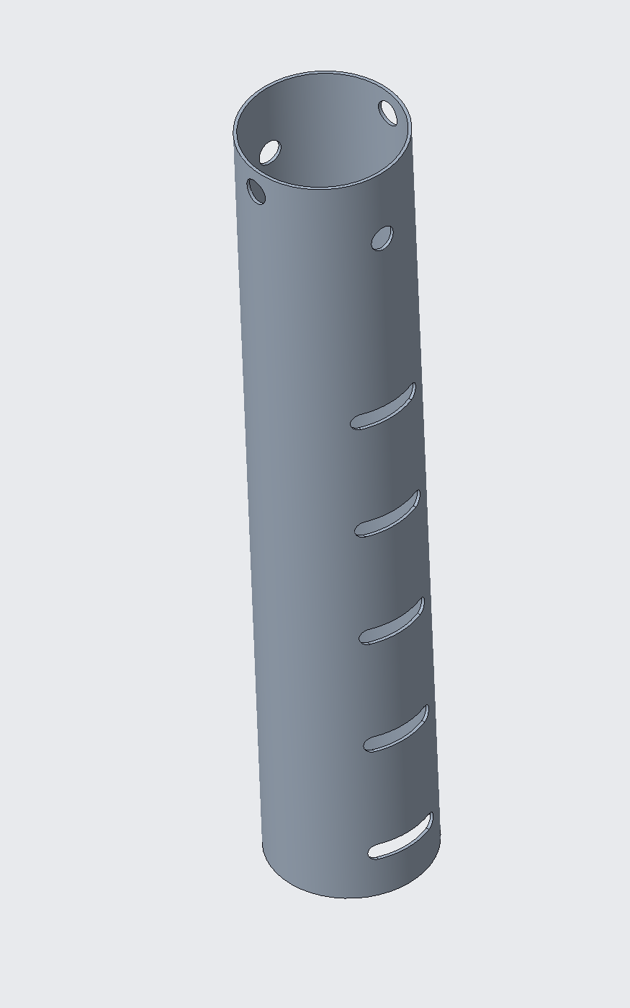
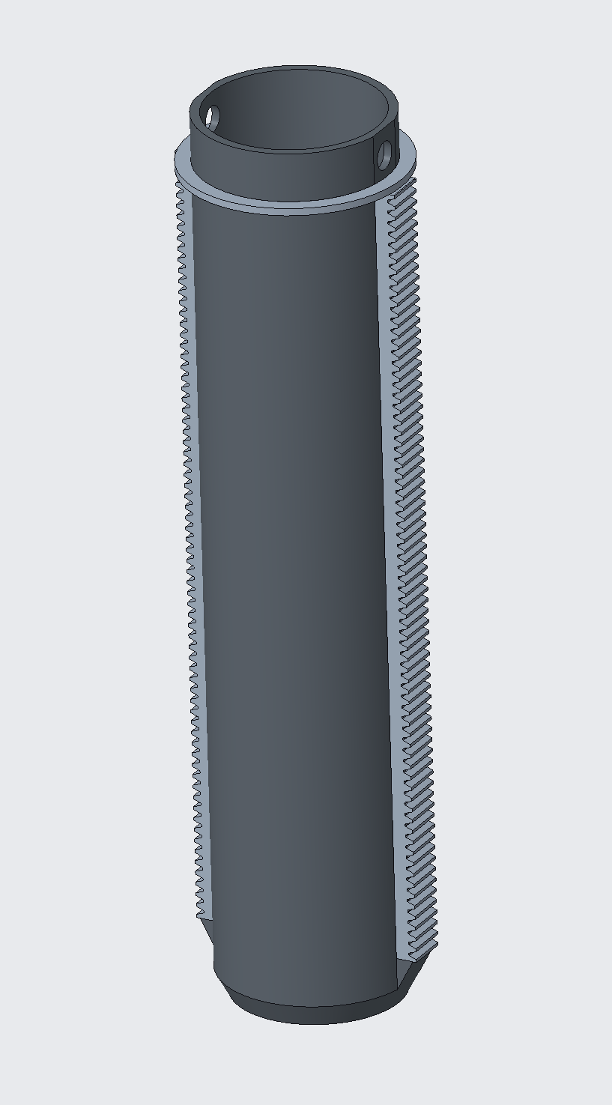
TerraProbe’s Key CAD Components
Unique Payload and Rack/Pinion Design for Soil Sampling
Base
Payload
Shell and Racks
Notes:
Chris

Slide 10
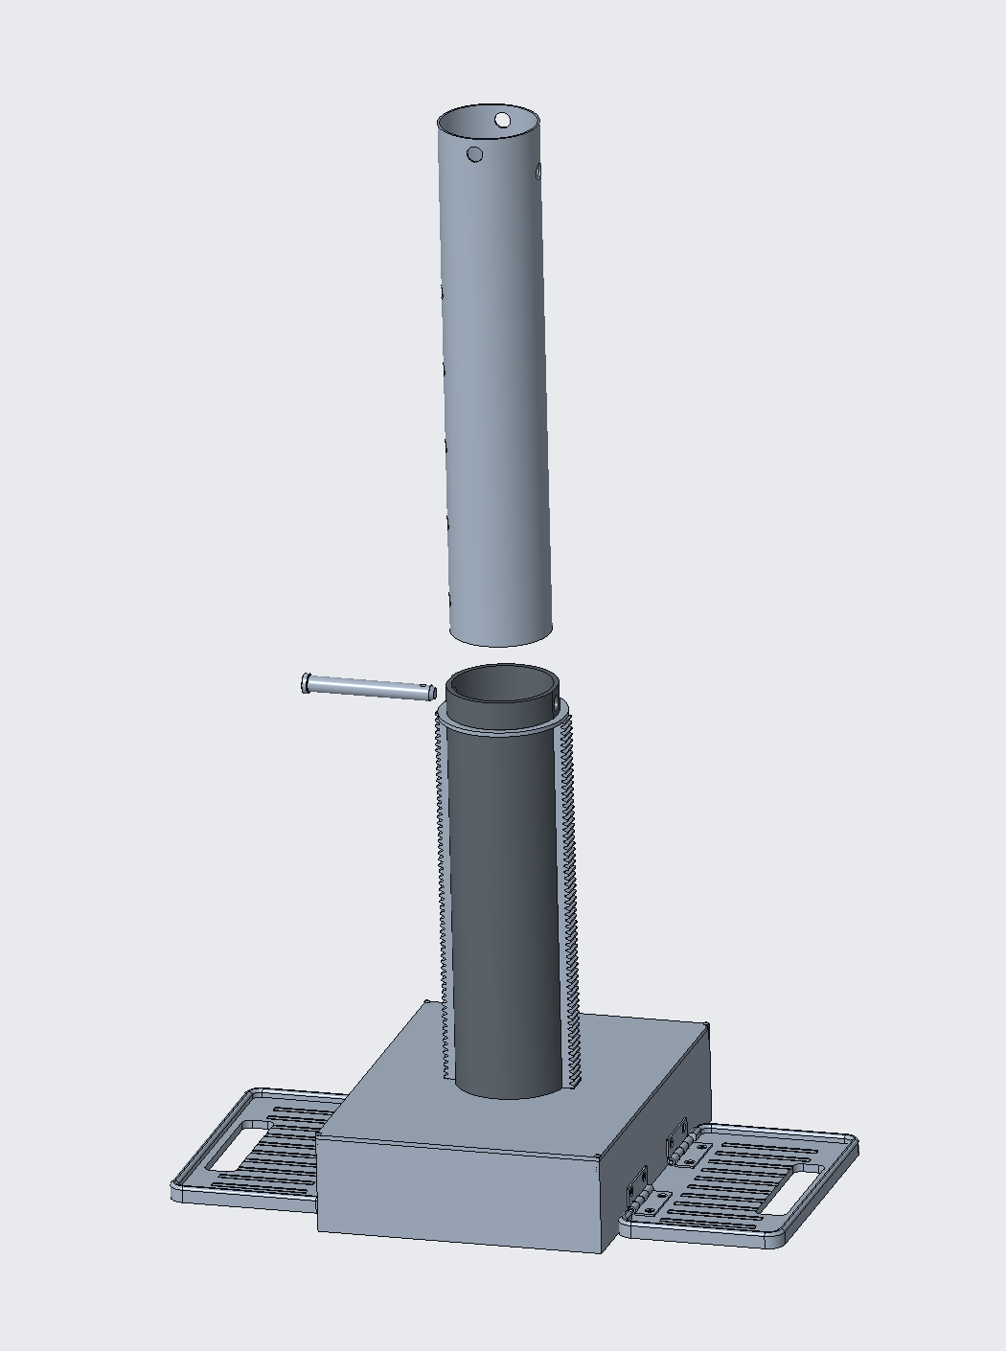
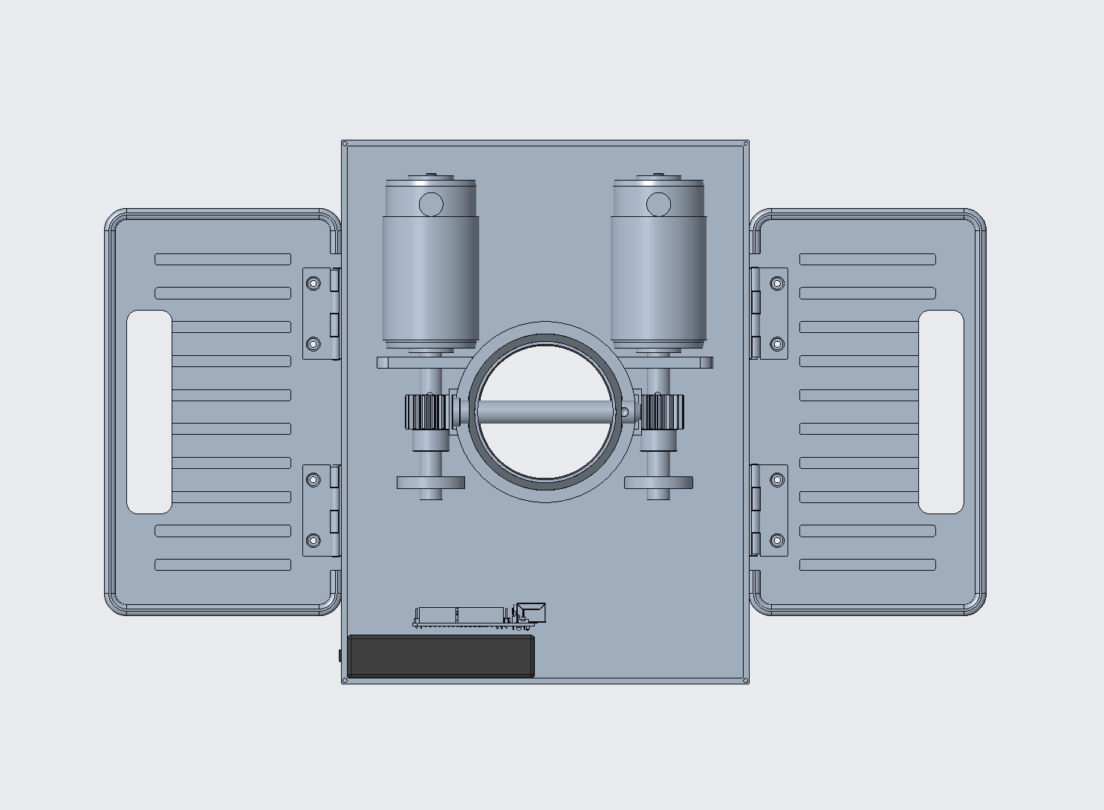
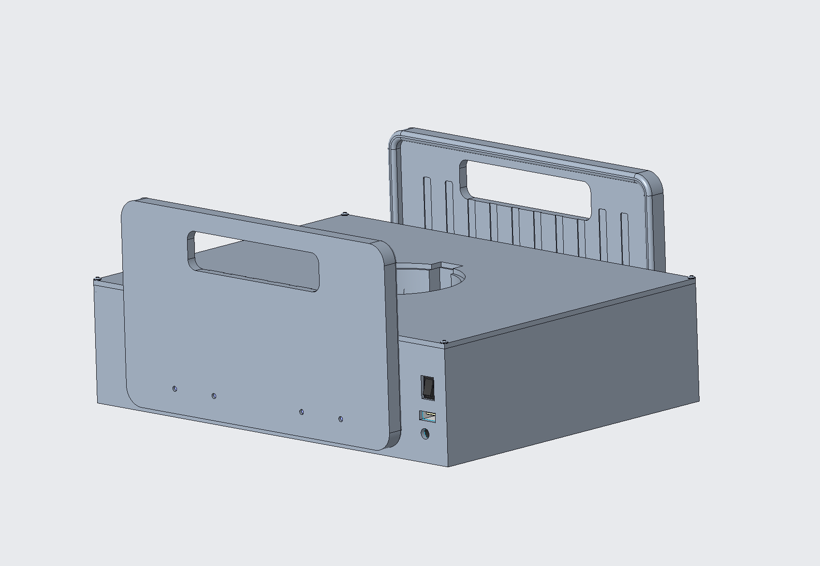
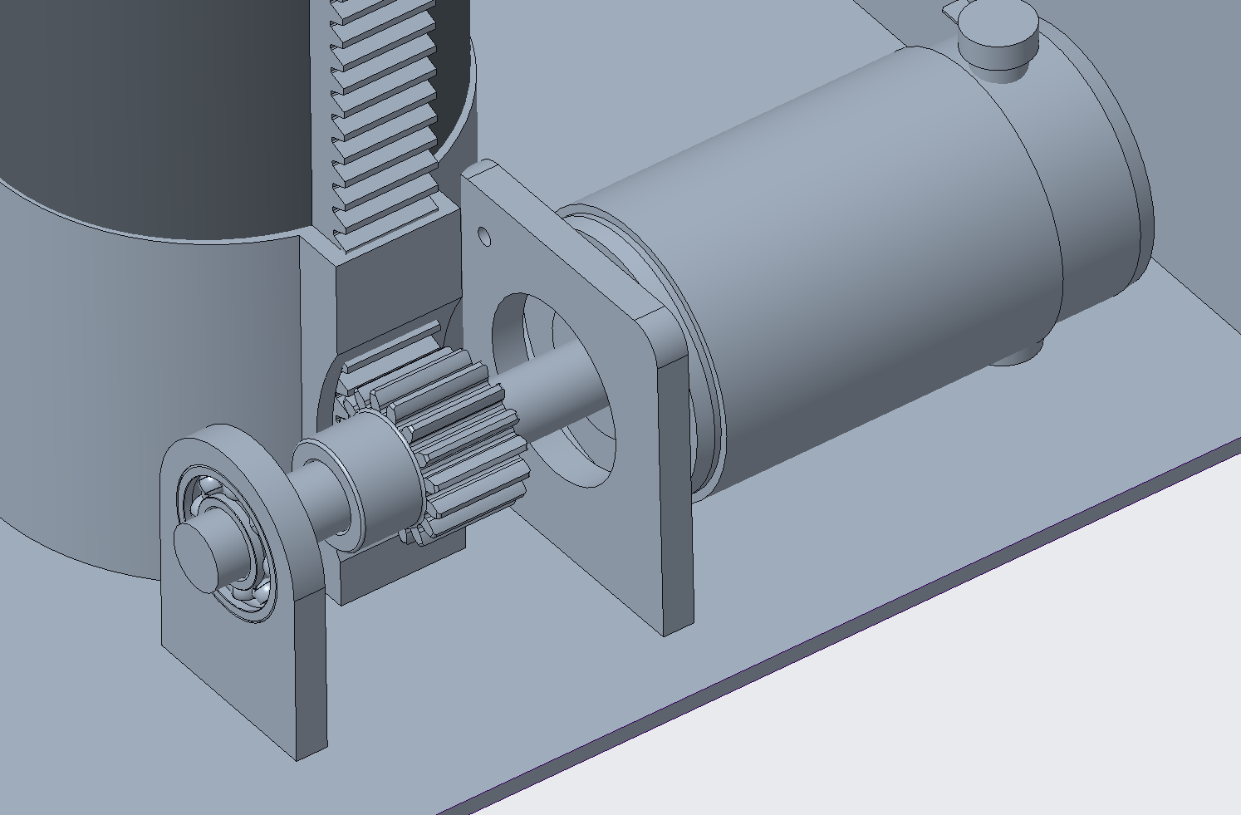
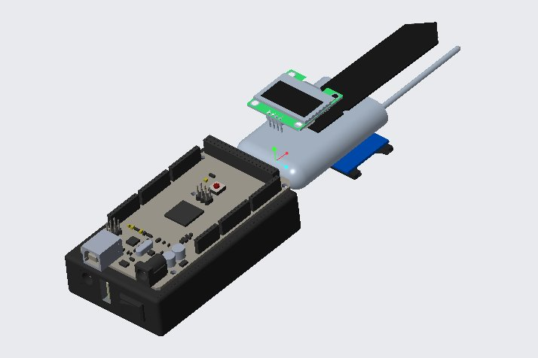
TerraProbe’s Sub-Assemblies
Payload for sampling, gear-shaft for power, and probe for real-time analysis.
Notes:
Chris

Slide 11
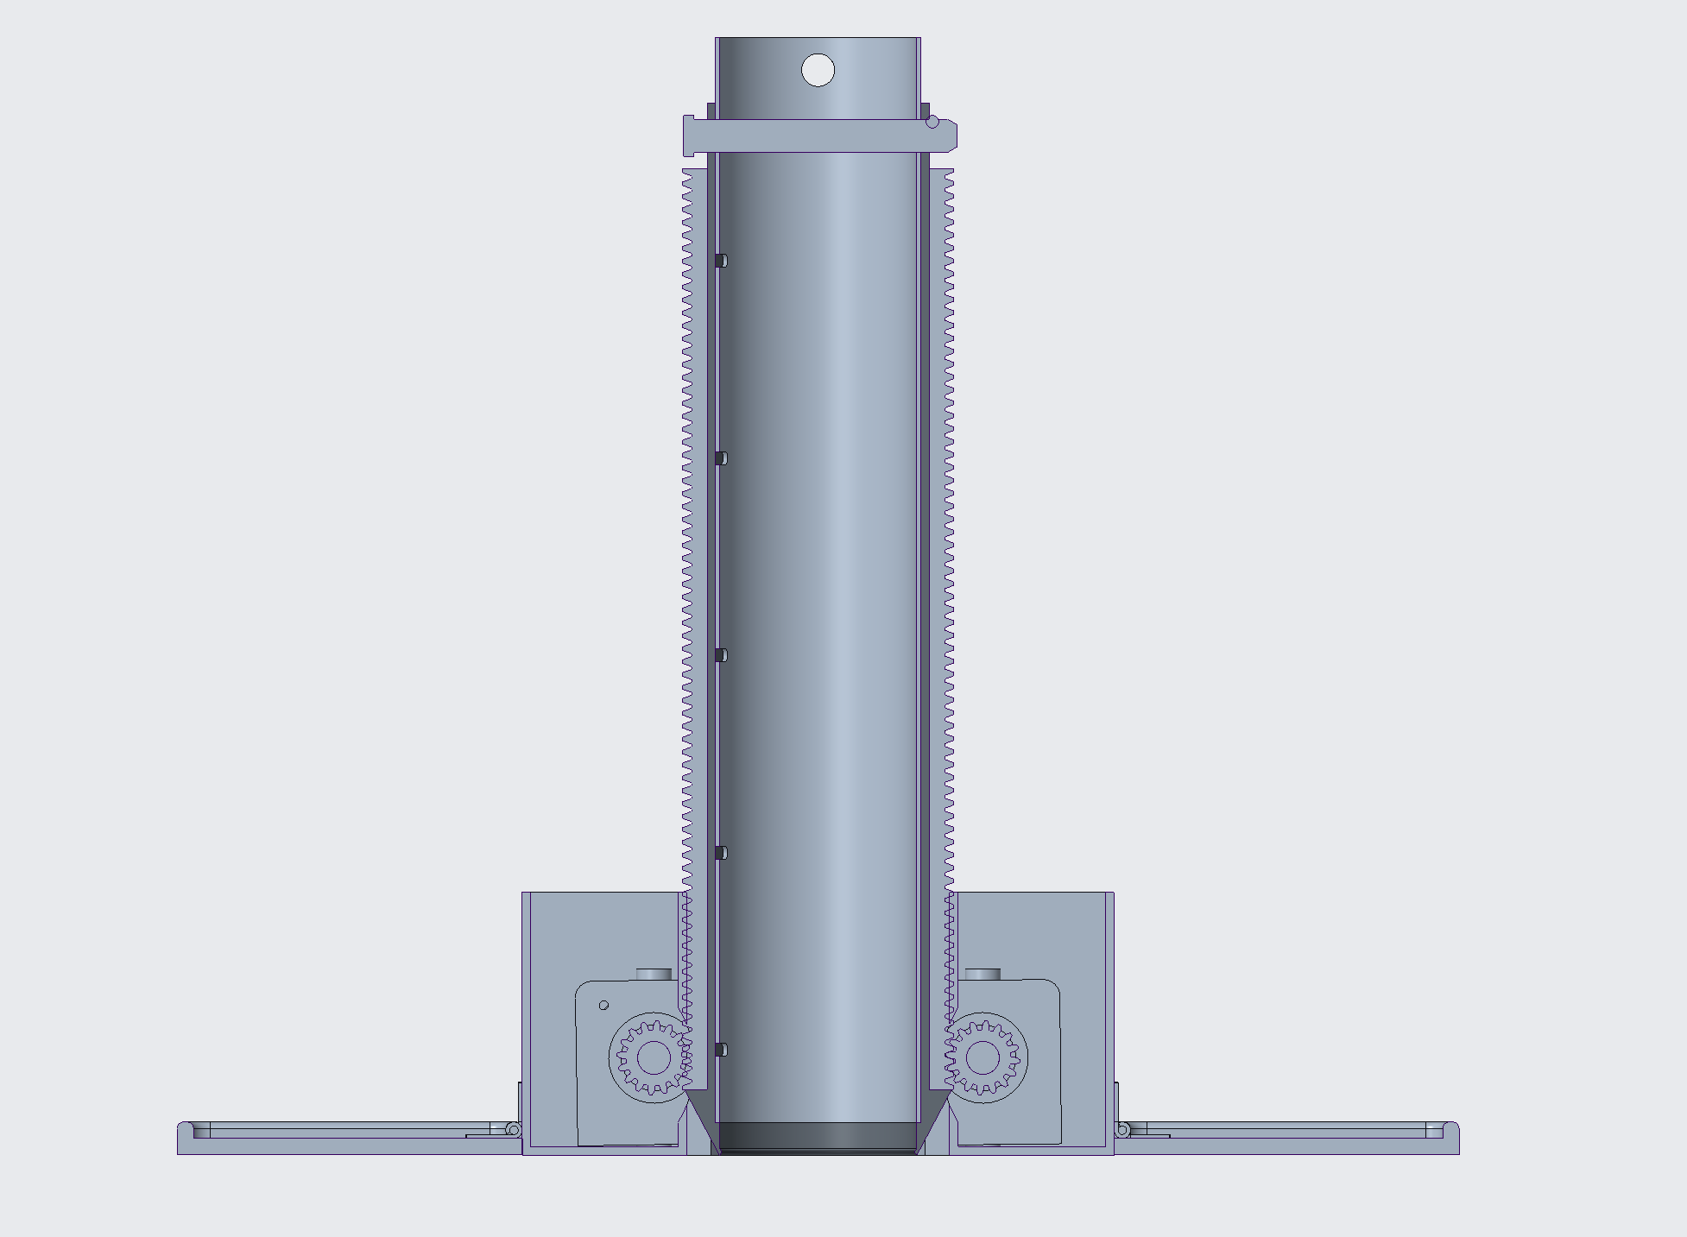
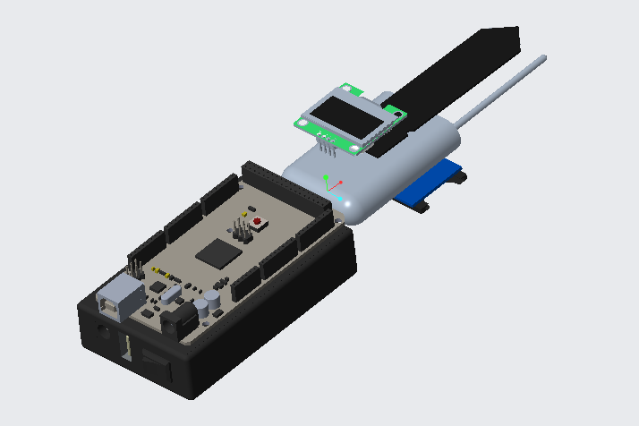
Pricing & Competitive Advantage
The model was adjusted to the new requirements and the required force was determined
Presenting an Intermediate Solution
TerraProbe DEVICE
MODULAR INNER TUBES
ANALYTICS SUBSCRIPTION
Cost: High-end solutions cost $5,000+, while cheaper alternatives lack precision and automation.
Operation: Instant soil collect and health insights, reducing analysis time from weeks to minutes
Portability: Lightweight, automated, and no operator required
Recurring Revenue Model: Sustainable model with consumables and data-driven services
Portable & Automated Soil Burrowing System & Testing Probe
Replicable inner component for multi-depth sampling and collection
Real-time soil health insights via a digital dashboard
Sell Price: $1050 per unit
Sell Price: $130 per unit
Subscription: $12/month per unit
Notes:
Sankaran

Slide 12
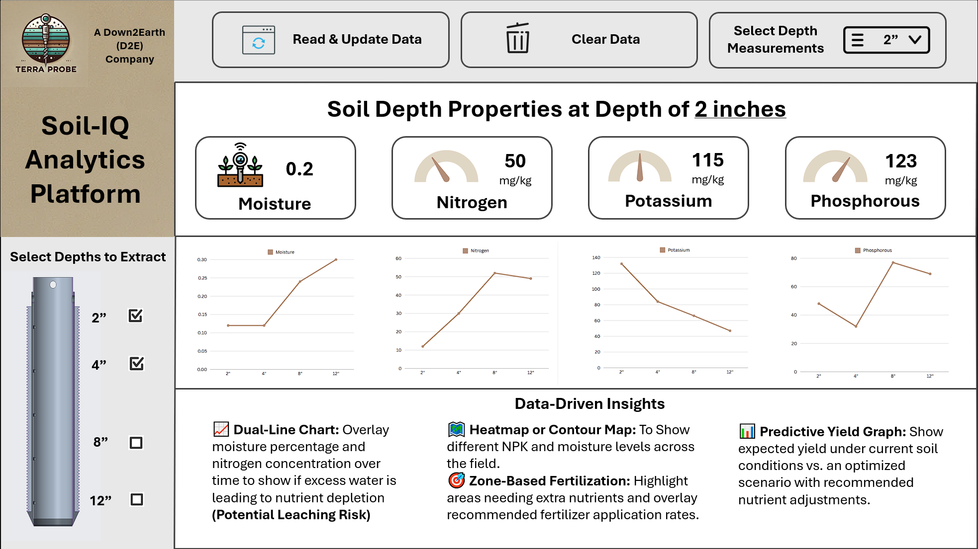
TerraProbe Soil-IQ Dashboard
Digitally Enabling Competitive Advantage through Soil Health Analytics
Soil-IQ Analytics
SD Card Integration: Seamless transition from Testing Probe to Data Visualization
Real-Time Visualization: Interactive dashboard powered by Python & Streamlit
Predictive Analytics: Forecasts yield projections to optimize fertilizer application and crop yield.
User-Friendly Interface: Simplified design enabling easy navigation and test measurements
Notes:
Sankaran

Slide 13
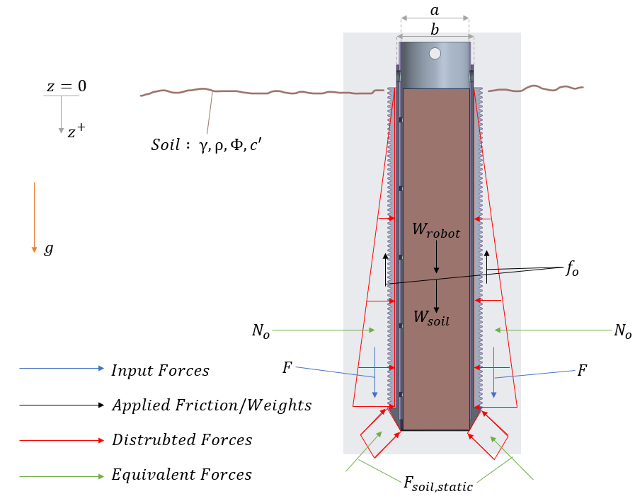
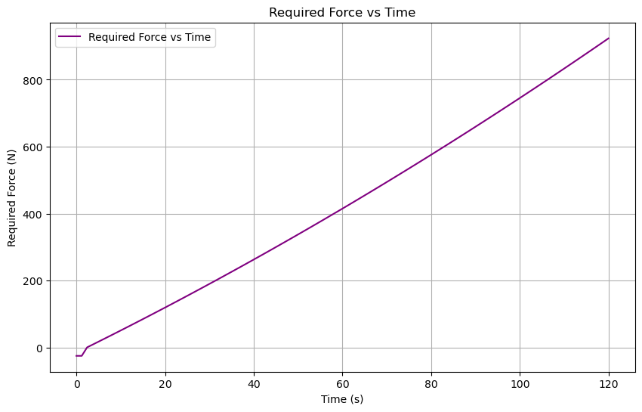
Analysis: Pinion & Rack, Force Soil Modelling
The model was adjusted to the new requirements and the required force was determined
Determined desired acceleration, velocity and position
Calculated Force : 923 N
Motor requirements for the same : 35 W and 27.5 RPM
The Rankine Theory : used to compute the lateral soil pressure on the sides of the guidance system
Friction on the inside is considered negligible due to mechanical changes – more on this later
Notes:
Loki

Slide 14

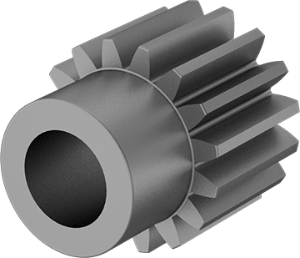
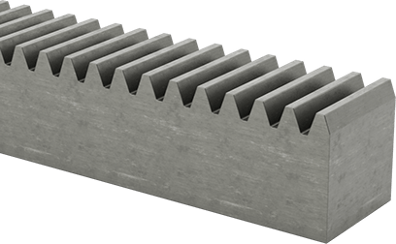
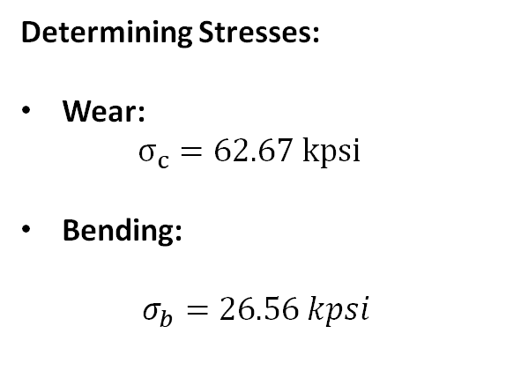
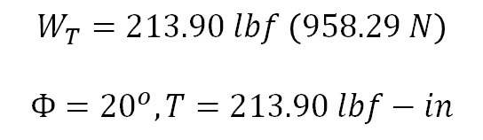
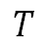
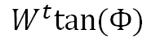
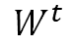
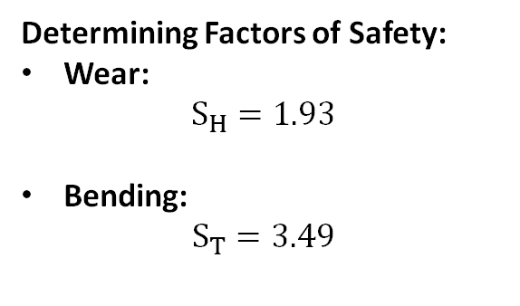
Analysis: Gear Failure
Steel 1144 Hardened can be used for the pinion – Factors of safety of 1.93 and 3.49 for wear and bending
Determining Loads:
Determining Stresses:
Wear:
$$σ_{c}=62.67 kpsi$$
Bending:
$$σ_{b}=26.56 kpsi$$
Determining Factors of Safety:
Wear:
$$S_{H}=1.93$$
Bending:
$$S_{T}=3.49$$
$$T$$
$$W^{t}tan⁡(Փ)$$
Pinion and Rack choices : *(All Choices follow AGMA Standards)
Minimum # of Teeth – 16
Pinion Diameter – 1 inch
Rack/Pinion Pitch – 16 teeth/ inch
Material : AISI 1144 Hardened Steel
Parts from McMaster Carr
$$W^{t}$$
$$W_{T}=213.90 lbf \left(958.29 N\right)$$
$Փ={20}^{o}, T=213.90 lbf−in$
Notes:
Lokesh

Slide 15
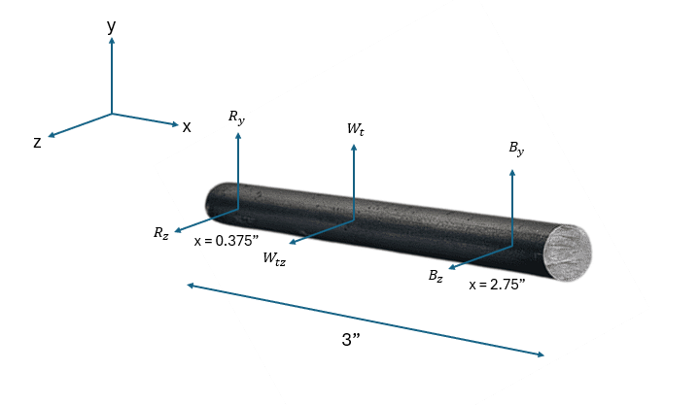
Analysis: Shaft Design
Shaft design optimized for strength, reliability, and seamless power transmission
Influence of Shaft, Key, & Bearings Design
Shaft (Diameter 0.5”, Length 3” – AISI 4140 Steel)
Connects the motor to the gear system
Fatigue Factor of Safety: 4.4
Yielding Factor of Safety: 8.8
Gear & Key
Key (0.125” x 0.125” x 0.25” – Square Key, AISI 1045 Steel)
Critical for tight fit with the gear
Shear & Crushing FOS: 1.5 (AGMA Standard Compliant)
Torque Transmission: 106 lbf-in
Motor-Shaft Assembly
Bearing
Bearings (McMaster-Carr 60455K291)
Prevents failures due to excessive stress, misalignment, or wear
Static Load Capacity: 530 lbf
Dynamic Load Capacity: 1140 lbf
Max Speed: 25,000 RPM
Notes:
Sankaran

Slide 16
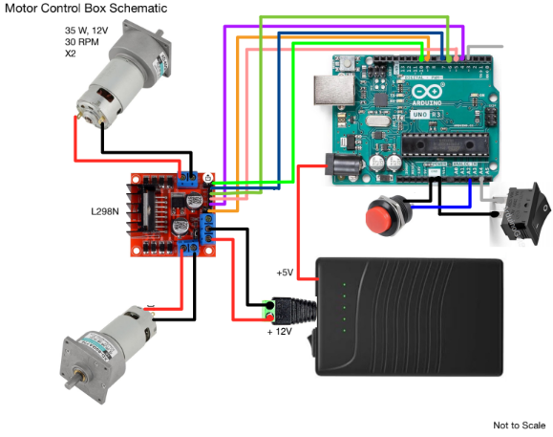
Motor Driver System - Electrical Diagrams
Controls power and direction for precise soil sampling operations
Main Controller: Arduino Uno
14 digital output pins
UART
Motor Driver – L298N
Module Control
Limit Switch Button
Emergency Stop Switch
Motors
35 W, 12 V
30 RPM
High torque, Low RPM
Notes:
Avie

Slide 17
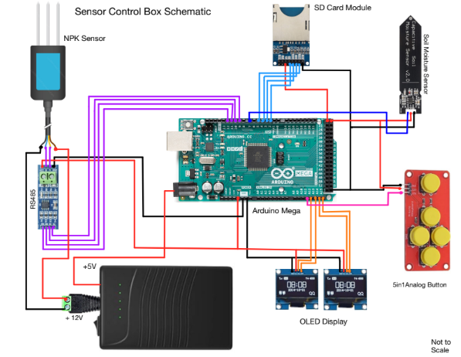
Data Acquisition System Electrical Diagrams
Captures real-time soil metrics for accurate analysis and decision-making
Main Controller: Arduino Mega
54 digital output pins
UART
Data Collection
SD Card Module
5in1 Analog Button
OLED Display – User Interface
Sensors
Capacitive Soil Moisture
NPK (Nitrogen, Phosphorous, Potassium)
Battery
12 V – NPK
5V – Arduino Uno
Notes:
Avie

Slide 18
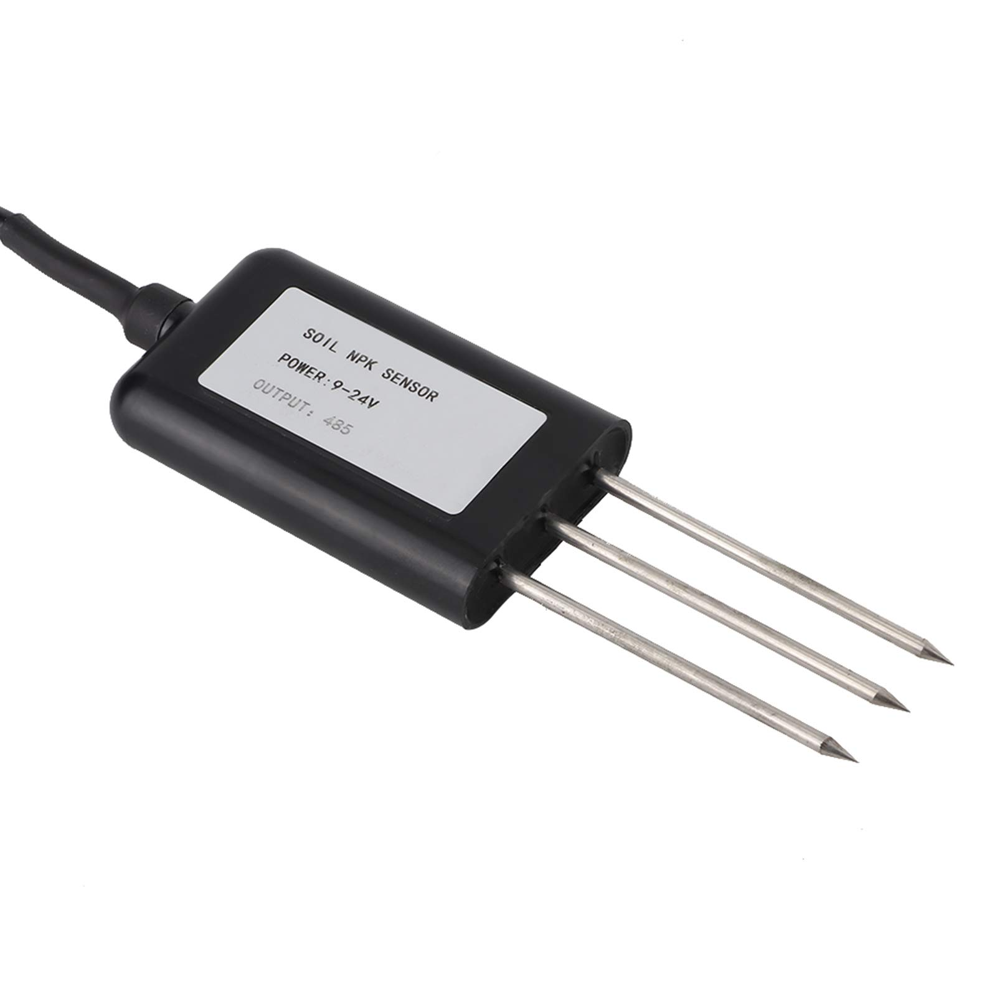
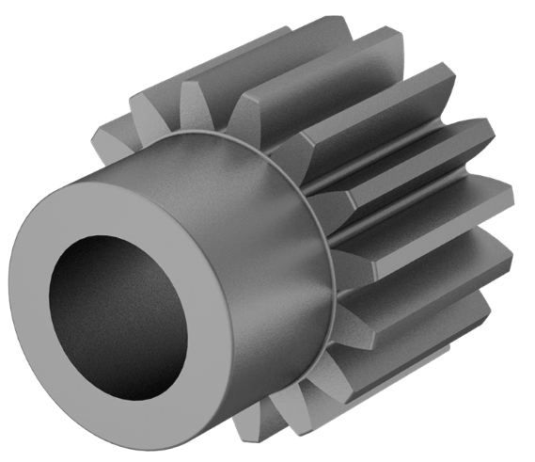
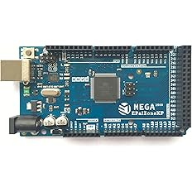
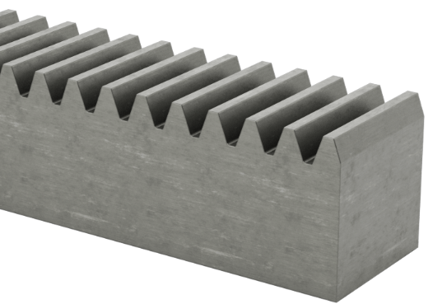
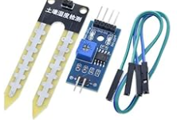
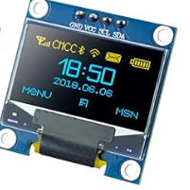
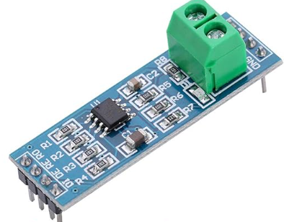











BOM: Materials & Costs / Sourcing Plan
TerraProbe plans to spend ~$448 to build its production prototype
Amazon
McMaster-Carr
Purdue ME Shop / Personal
Subtotal: $214.36
Subtotal: $233.83
Subtotal: $0.00
Total: $448.19
Notes:
Jacob

Slide 19



Economic Analysis
TerraProbe presents strong scalability and projects to break even in ~3.5 years
Revenue Streams
Hardware Sales
Consumables & Replaceable Parts
Software & Data Services
Handheld Sensor Probe
Base Unit (TerraProbe device)
Inner Payloads
Maintenance (Potential Revenue Stream)
Basic Dashboard Access (Free)
Premium Data Insights (Fee)
Production Cost
→
TerraProbe
$832.93
→
Inner Tube
$84.24
Margin & Sell Price - TerraProbe
25% GM → $1050 MRP
Margin & Sell Price – Inner Tube
50% GM → $130 MRP
10-Year Annual Revenue
$50M
10-Year ROI
Targeting 20% of Small/Medium Acreage Farms over 10 years (~175,000 units)
33%
3/31/23 ‹#›
Notes:
Sankaran

Slide 20
Manufacturing & Assembly Plans
Structured assembly process with in-house fabrication and precise sourcing to meet production goals
Component | Make/Buy | Justification
Inner Payload | Make | Requires specific shapes that are best controlled in-house.
Outer Payload | Make | Custom design requirements make in-house production preferable.
Sensor Probe Casing | Make | Custom casing ensures proper fit for sensors and electronics.
Foot Pedals | Make | Custom design is required to meet project needs.
Sensors | Buy | Precision components that are not feasible to manufacture.
Electronics | Buy | Specialized components requiring external sourcing.
Batteries | Buy | Standardized and regulated components best sourced externally.
Gears | Buy | Complex manufacturing process and high production cost.
Shafts | Buy | Bought at standard size and manufactured as needed by ME shop.
Motors | Buy | Precision-engineered components requiring external expertise.
Notes:
Jacob

Slide 21
Testing & Validation Plan
Testing individual components to subassemblies, culminating in full system integration
Preliminary Testing
Motors
Sensors
OLED Display
Key/Gear/Shaft
Subassembly Testing
Motor-pinion-rack system
Soil Collection
Probe, data analytics
Notes:
Jacob

Slide 22

Risk Analysis & Safety Considerations
TerraProbe’s Failure Mode Effects Analysis (FMEA)
Notes:
Sankaran

Slide 23







Current State & Path Forward
TerraProbe is on track for viable impact
Current State
Project is on schedule – CAD & Mfg/Testing Plan Developed
~$215 spent (Low-Risk Parts) & $785 of budget remains
Path Forward
Place Order for High-Risk Parts – Roughly $200-350 in cost
Testing (Sensor Accuracy/Calibration), Tolerances & Tight Fits
Business Impact
Intermediate– Low-end usability and high-end features
Empower Small Farms – Data-driven decisions for better yields
Notes:
Sankaran

Slide 24
Thank you
Any Questions?

Slide 25

References
Following are used in the development of this CDR
Crop Nutrition. (n.d.). Third-party soil sampling: What you need to know. Retrieved
February 6, 2025, from https://www.cropnutrition.com/resource-library/third-party-soil-sampling-what-you-need-to-know/
North Carolina State University Extension. (n.d.). Careful soil sampling: The key to reliable
soil test information. Retrieved February 6, 2025, from https://content.ces.ncsu.edu/careful-soil-sampling-the-key-to-reliable-soil-test-information
Soil Science Society of America. (n.d.). Self-study exam: Soil sampling and testing.
Retrieved February 6, 2025, from https://www.soils.org/files/certifications/certified/education/self-study/exam-pdfs/243.pdf
California Department of Transportation. (2011). Trenching and shoring manual.
Retrieved February 6, 2025, from https://engineering.purdue.edu/~frosch/ftp/Talbott/11%20-%20References/files/California%20Trenching%20and%20Shoring%20Manual.pdf
CB Insights. (n.d.). Agriculture tech trends. Retrieved February 6, 2025,
from https://www.cbinsights.com/research/agriculture-tech-trends/
Engineering News-Record. (n.d.). Market data. Retrieved February 6, 2025,
from https://www.enr.com/market_data
Gartner. (n.d.). Market research methodologies. Retrieved February 6, 2025,
from https://www.gartner.com/en/research/methodologies/market-research
Grand View Research. (n.d.). Soil testing market size, share & trends analysis report.
Retrieved February 6, 2025, from https://www.grandviewresearch.com/industry-analysis/soil-testing-market
Grand View Research. (n.d.). Smart agriculture market size, share & trends analysis report.
Retrieved February 6, 2025, from https://www.grandviewresearch.com/industry-analysis/smart-agriculture-farming-market
Notes:
Avie

Slide 26
References
Following are used in the development of this CDR
International Food Policy Research Institute. (n.d.). Publications. Retrieved February 6,
2025, from https://www.ifpri.org/publications
Mordor Intelligence. (n.d.). Geotechnical engineering market - growth, trends, COVID-19
impact, and forecasts. Retrieved February 6, 2025,
from https://www.mordorintelligence.com/industry-reports/geotechnical-engineering-market
NASA. (n.d.). Earth science. Retrieved February 6, 2025,
from https://science.nasa.gov/earth-science/United Nations Environment
Programme. (n.d.). Resources. Retrieved February 6, 2025, from https://www.unep.org/resources
United States Department of Agriculture, Economic Research Service. (n.d.). Home page.
Retrieved February 6, 2025, from https://www.ers.usda.gov
The World Bank. (n.d.). Agriculture and rural development. Retrieved February 6, 2025,
from https://data.worldbank.org/topic/agriculture-and-rural-development
Envirotecnics. (2020). AMS soil sampling. Retrieved February 6, 2025,
from https://www.envirotecnics.com/wp-content/uploads/2020/07/AMS-soil-sampling-envirotecnics.pdf
Notes:
Avie

